Slide 1
Spotify Music Recommandation Engine
Irpan Yierpan, Keifer Convertino

Slide 2
Project Overview
Music is a big part of people’s lives.
Something that may help someone on a stressful day.
Something that can help the music composing community.
Our project will have two features that target two different groups of people, listeners and artists.
Notes:
I: Music is a big part of everyone’s live as most of us listens to music every day.
Music can effect our emotions and it can bring positivity to our lives.
Thats why we want to make something that can help you find the music you need and also help the music composing community to produce bette and more likeable music.
Kiefer, you can continue with something like “therefore, we are making an interface that have two features….. “, etc, and go to explain the listener use case in the next slide.
K: two use cases: listener vs. artists

Slide 3
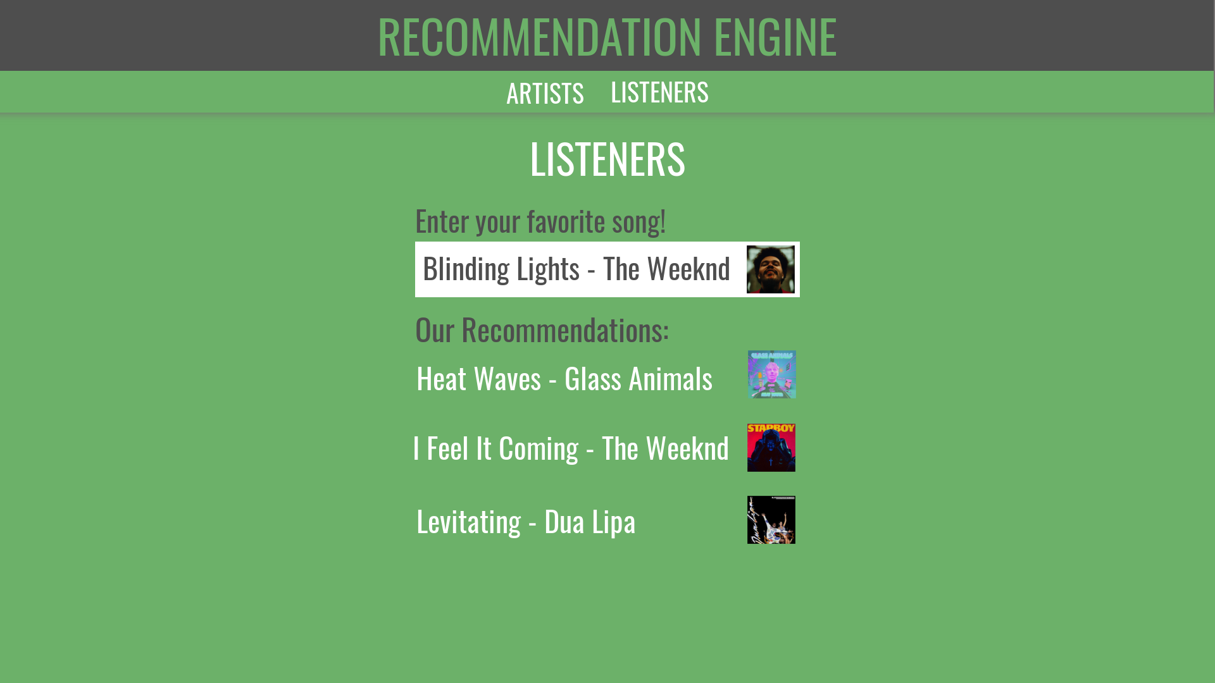
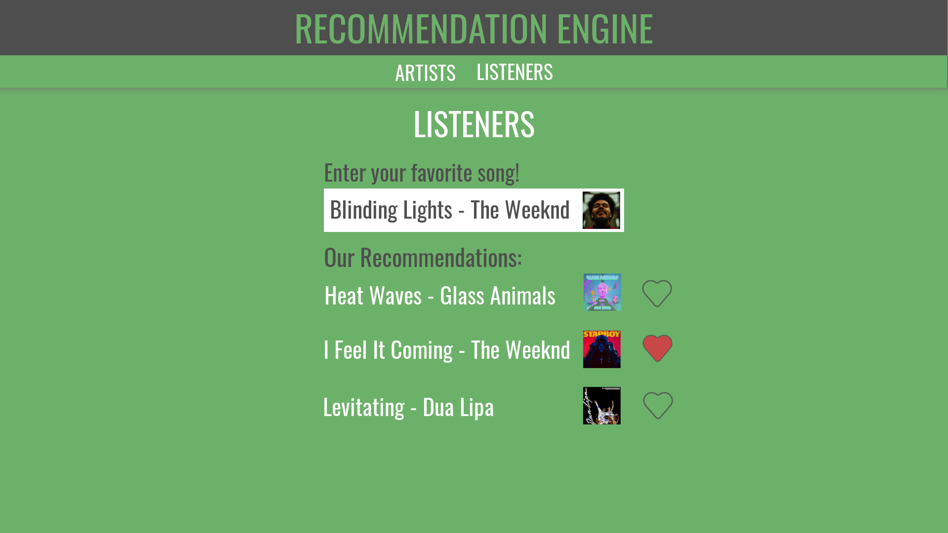
Mock Frontend
Notes:
K:
For listeners:
Provide a tool that will allow listener’s to discover music that is similar to their favorite songs.

Slide 4
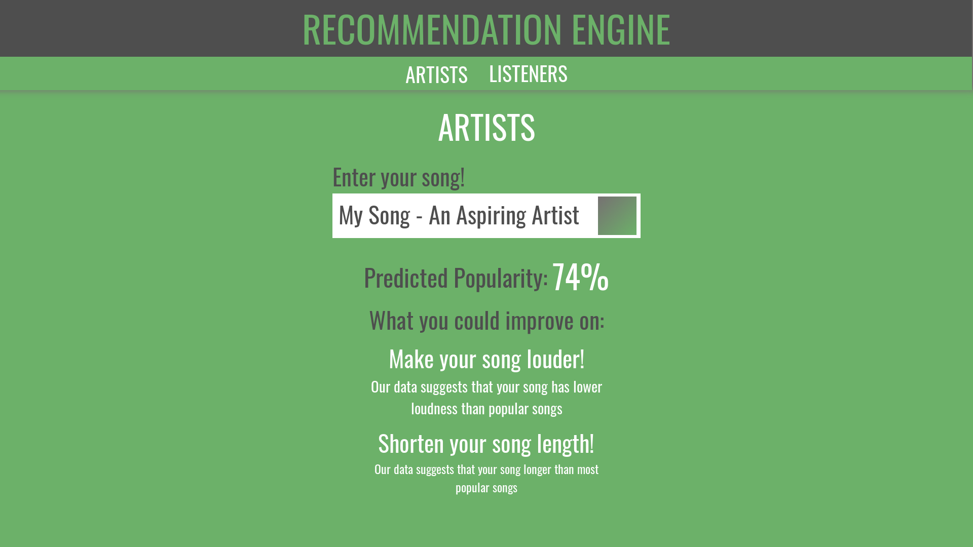

Notes:
I:
For artists:
Our project can help analyze their music and provide suggestions on how they can make it more popular.

Slide 5
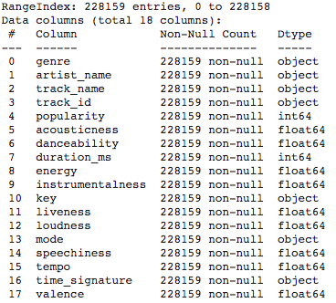
Dataset Overiew
Dataset of songs in spotify
And their “audio features”
Each track is identified by a track id
Can be used with Spotify API
228159 Tracks x 18 Variables
No missing data
Link: https://www.kaggle.com/huanntran100/spotify-song-popularity-prediction/data
Notes:
K

Slide 6
Numeric Features
Numeric Audio Features
acousticness
danceability
energy
instrumentalness
liveness
loudness
speechiness
tempo
valence
Other Numeric Features
duration_ms
Notes:
I:

Slide 7
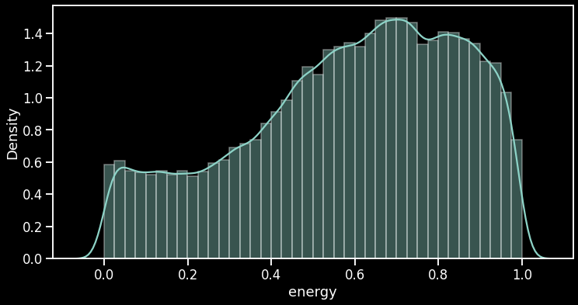
Energy
A perceptual measure of the intensity and activity of a track
For example, death metal is highly energetic, while a classical prelude is not.
Range is 0.0 - 1.0
A value of 1.0 represents that Spotify believes that track is very energetic
Notes:
I: Slightly skewed left, meaning songs on spotify tend to be more energetic

Slide 8
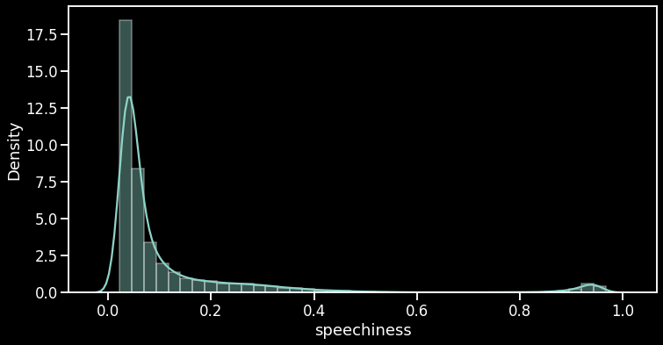
Speechiness
Detects the presence of spoken word in track.
Range is 0.0-1.0
Trackes with values above 0.66 are most likely entirely spoken word.
Tracks with values between 0.33-0.66 likely contain both music and speech.
Traks with values below 0.33 are likely entirely musical
Notes:
I: Most songs are under 0.4(meaning their are musical) with another cluster close to 1.0(meaning they are spoken words)

Slide 9
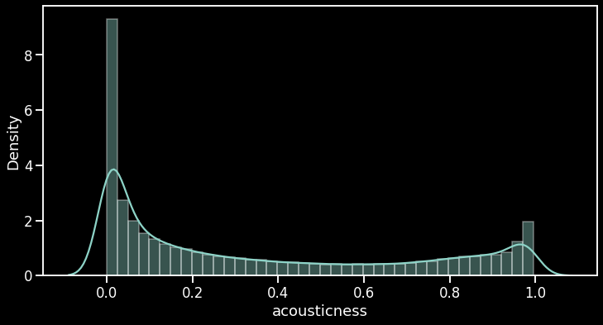
Acousticness
A confidence measure for if a track is acoustic
Range is 0.0 - 1.0
A value of 1.0 represents that Spotify has high confidence that the track is acoustic.
Notes:
K

Slide 10
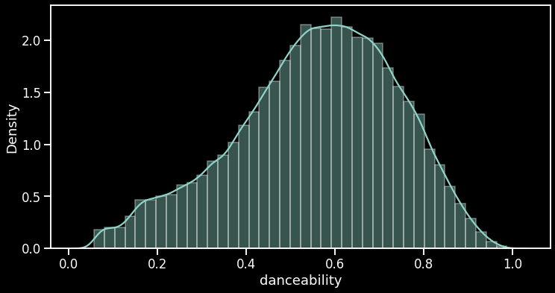
Danceability
How suitable a track is for dancing, based on elements like tempo, rhythm stability, beat strength, and overall regularity.
Range is 0.0 - 1.0
A value of 1.0 represents that Spotify believes that track is very danceable
Notes:
K

Slide 11
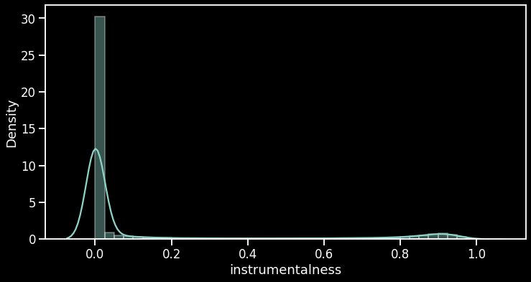
Instrulmentalness
A metric measuring whether a track contains no vocals
Range is 0.0 - 1.0
Instrulmentalness > 0.5 suggests the track is instrumental, with a higher value indicating higher confidence.
Notes:
I: May consider changing into categorical or dropping it as most songs are close to 0.

Slide 12
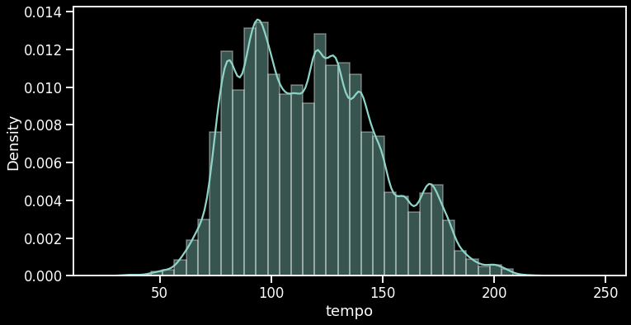
Tempo
The overall estimate of a track’s tempo in BPM
Practical range is from arond 30 to 240
Notes:
I: Beats per minute, how fast or slow is the song

Slide 13
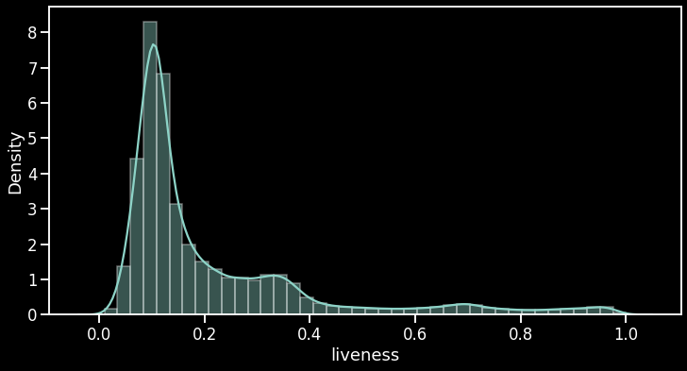
Liveness
A confidence measure for whether Spotify thinks that a track is performed live.
Range is 0.0 - 1.0
Liveness > 0.8 strongly suggests that the track was performed live.
Notes:
K

Slide 14
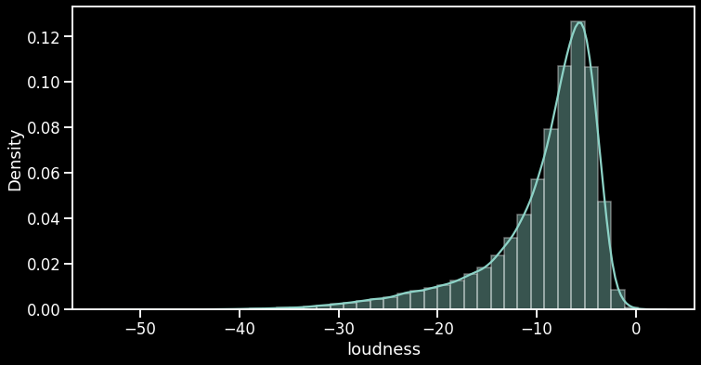
Loudness
The overall loudness of track in decibels
Typical range is -60 to 0 dBs
Notes:
K

Slide 15
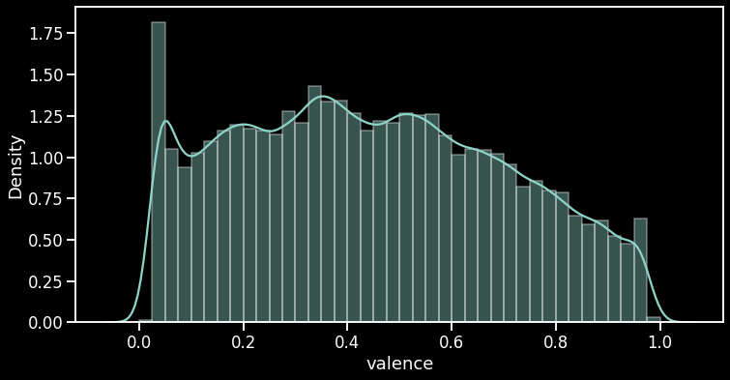
Valence
A measure indicated the musical/cheerfulness positiveness of a track
Range is 0.0 - 1.0
Higher values indicated more positive tracks.
Notes:
I

Slide 16
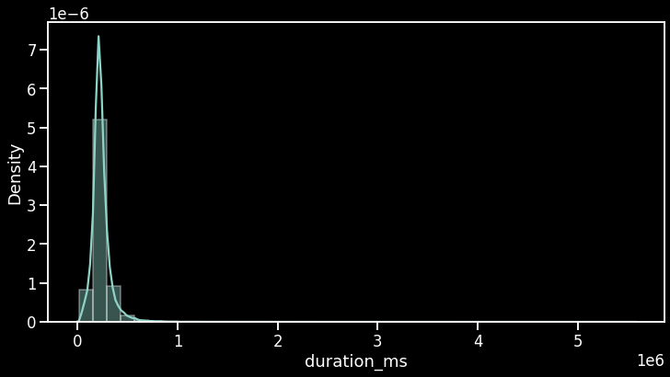
Duration
The length of the track in milliseconds
Contains outliers because some tracks are poscasts
Notes:
I

Slide 17
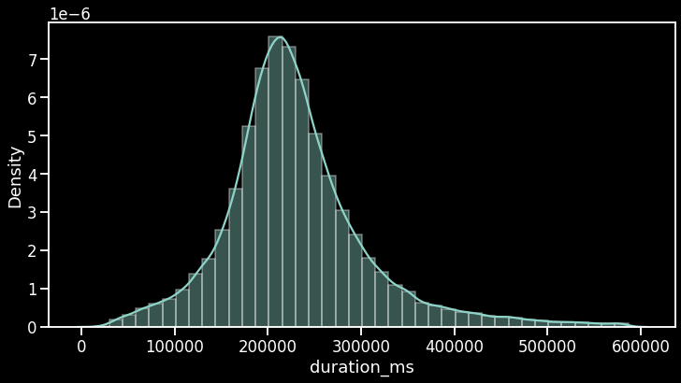
Duration(+/-3 std)
Now, all tracks are between 15509ms and 586588ms
(~ 0.26 min - 9.78 min)
Notes:
I

Slide 18
Categorical Features
Categorical Audio Features
mode
key
time_signature
Other Categorical Features
artist_name
genre
Notes:
I:

Slide 19
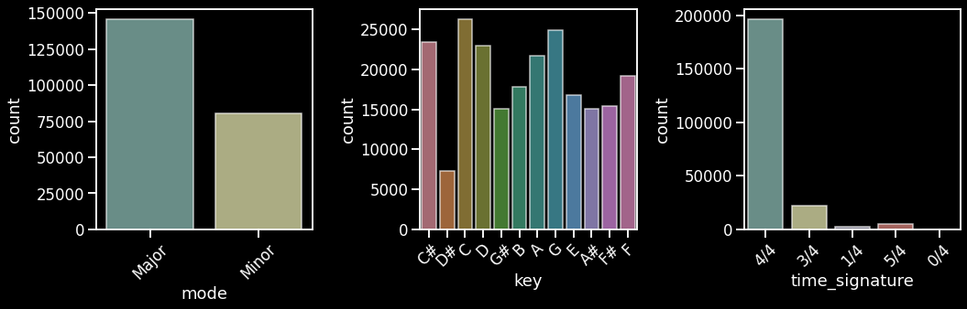
Categorical Audio Features
Notes:
I:
Most songs are 4/4, so we may drop time_signature

Slide 20
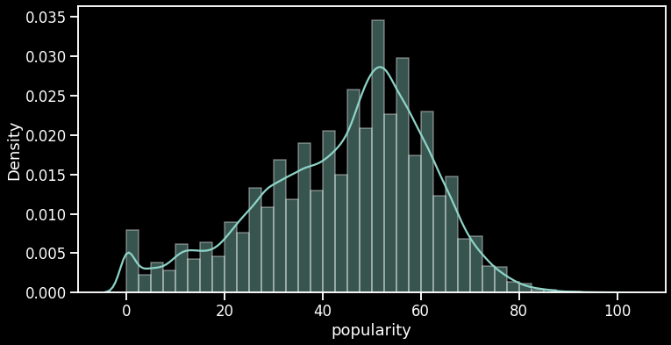
Label
For listener recommendations, we plan on using kNN against a preexisting dataset of songs to make recommendations, so there is no label needed.
For our tool for artists, the label with be popularity - a measure of how many plays a track has all time and how many plays it has received as of late.
Notes:
K:

Slide 21
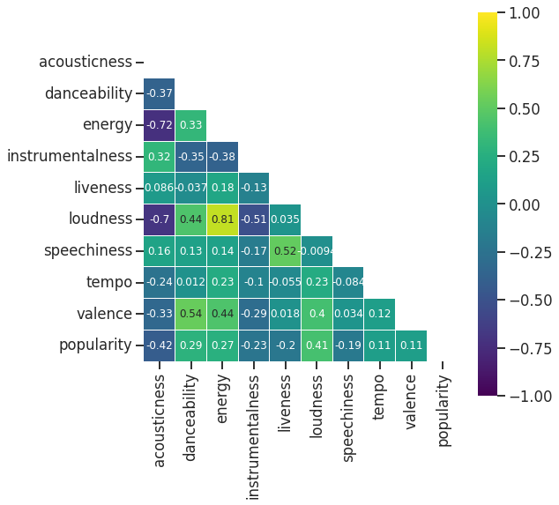
Correlations
Highly Correlated Features:
Energy vs. Loudness (+0.81)
Acousticness vs. Energy (-0.72)
Acousticness vs. Loundness (-0.70)
Valence vs. Danceablity (0.54)
Speechiness vs. Liveness (0.52)
Valence vs. Energy (0.44)
Top Features Correlated to Popularity:
Acousticness (-0.42)
Loudness, Danceablity, Energy (0.41, 0.29, 0.27)
Notes:
I:
Feature correlations makes sense as:
energetic songs are louder
acoustic songs are more calm and less energetic/lound
nothing unexpected
Intersting findings in correlation to popularity
people tend to dislike more acoustic songs
people tend to like more lound and energtic songs

Slide 22
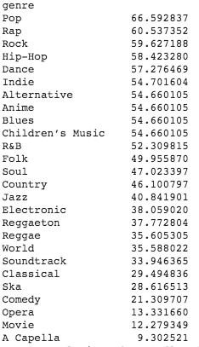
Genre Popularity
Certain genres are more popular than others.
Certain genres may have different features that fans of that genre like.
Could need to account for this in tool for artists.
Maybe develop a model for each genre.
Notes:
K:

